Slide 1


27 September 2010
Tech Talk Cedar Valley

Slide 2

Hi
allyn.bauer@t8webware.com
meetup.com/tech-talk-Cedar-Valley
github.com/ajb/Tech-Talk-Cedar-Valley
ustream.tv/channel/tech-talk-cedar-valley
Notes:
Introduction. Slight pauses, please ask questions. We now have a github repo for resources. uStream? My never updated web presence..

Slide 3

Intro
iPhone is really iOS
iOS is just the OS
Tools are important
iOS + a whole bunch else = platform
This (generally) applies to Mac too
Notes:
We can no longer talk just about iPhone because of the iPad – so what we really have is iOS. iOS is just the OS – other dev tools. Xcode, Interface Builder. Don’t forget about Mac too!

Slide 4
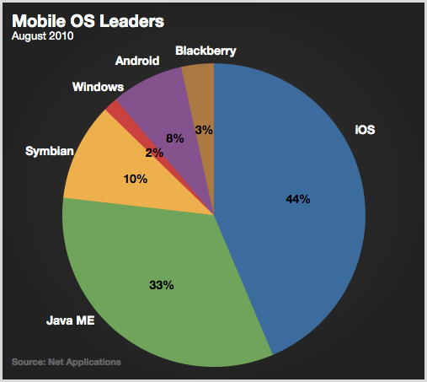
Notes:
iOS matters a lot. http://theappleblog.com/2010/09/01/ios-over-linux-today-android-over-ios-tomorrow/

Slide 5

Xcode
Impressive
Not required
Sign for distribution
Holy crap, docs!
More then just Xcode.app
Notes:
Wow, Xcode rules! But you don’t HAVE to use it. There are command line tools. Sign apps for distribution. Sucks to setup. Built in docs, Apple docs, very well done doc system. Really is the face of Apple’s developer tools. More then just Xcode.

Slide 6

Interface Builder
How can you hate drag and drop?
nib, xib
Outlets
Supports custom view objects
Xcode 4 is Xcode + Interface Builder
nibs are ready to go
Notes:
Apple’s drag and drop GUI editor/creator. Bundles components into NIB files. XIB is an XML NIB, for revision control / diff / etc. Can create custom view objects. Archived objects are ready to run and lazy loaded. Xcode 4 is will include IB+Xcode

Slide 7
Objective C
Is neat
Strict superset of C
Object Oriented (of course)
Smalltalk inspired sentences
2.0 has garbage collection (not on iPhone)
Interfacing quirks
Notes:
Objective C is fun. Strict superset, everything works from C. ObjC is object oriented, what else. C is the noodles, ObjC is a delicious sauce. ObjC 2.0 has garbage collection, no iPhone. Other languages interface (Ruby, Python) sentences interfere.

Slide 8
Cocoa
Apple API
Frameworks: Foundation, Application
MVC
KVC/KVO
Retain, release, autorelease
Notes:
Cocoa is an Apple API. Huge. Foundation, generic library, string manipulation, containers, iteration, etc. Application, build an App – GUI oriented. MVC, but really model viewcontroller. KVC key value coding, get arbitrary values by key. KVO, key value observing, watch arbitrary keys.

Slide 9
Cocoa (Memory)
You must manage objects you own
Conditions of ownership: alloc, new, retain
id obj = [[Object alloc] init]; // retainCount == 1
id obj = [Object new]; // retainCount == 1
id obj = [Object object]; // retainCount ≈≈ 0
int i = 5; // no retainCount

